Slide 1

2018 – 2019 NBA Stats & Rookie Review
By: Jogesh, Nicole, Steph, Brent
Notes:
We can predict best offensive team

Slide 2
Agenda
Data Introduction
NBA Definitions
Observations
Methodologies: Techniques applied
Takeaway

Slide 3
NBA Definitions
Points
Points scored by the player off that event type
Blocks
A block occurs when an offensive player attempts a shot, and the defense player tips the ball, blocking their chance to score
Steals
Number of times a defensive player or team takes the ball from a player on offense, causing a turnover
Assists
Rebounds
A rebound occurs when a player recovers the ball after a missed shot. This statistic is the number of total rebounds a player or team has collected on either offense or defense
FT%:
The percentage of free throw attempts that a player or team has made
FG%:
The percentage of field goal attempts that a player makes – Formula (FGM)/(FGA)
FG3%
Min/Game
The number of minutes played by a player or team
Games
The number of games a player or team played where a specific criteria occurred – minimum game played minimum 17
PER (Player Efficiency Rating)
The number of assists -- passes that lead directly to a made basket -- by a player
The percentage of a team's 3 point field goals that a player has made while on the court
A rating calculated by the NBA to measure a players efficiency. Includes all stats.
Notes:
https://stats.nba.com/help/glossary/#g

Slide 4
Observations
Observations
We are using NBA Player stats for the season 2018-2019 for clustering and logistic regression. We are also using first year player data for 2019-2020 for logistic regression.
Additional Measures
Based on minutes played by each player, we calculated Pts, Blocks, Assists & Rebounds. We forced all players to 32 minutes so the stats would be equal (for one logistic regression scenario).
We created additional attributes for logistic regression called PER Greater Than 20 [1=PER>20, 0=PER<20].
Model was executed on stats from 2018-2019 as a training data set. The results were applied on the first year player data as a testing data set.
Notes:
We clustered all players for 2018-2019
We created additional attributes for logistic regression called PER Greater Than 20 [1=PER>20, 0=PER<20]. This model

Slide 5
Analysis
Notes:
We clustered all players for 2018-2019
We created additional attributes for logistic regression called PER Greater Than 20 [1=PER>20, 0=PER<20]. This model

Slide 6
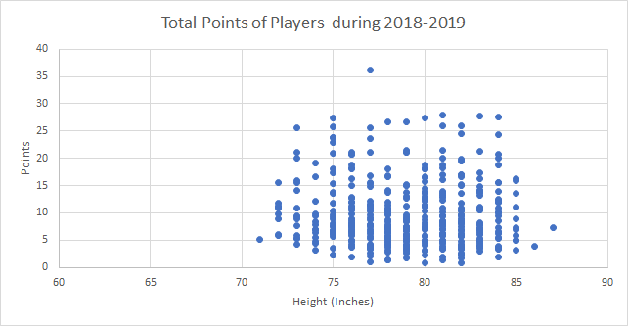
There is a positive correlation between a player's height and the total number of points earned by a player.
The taller a player is the higher the player's points will be.
It’s intuitive that the taller players have higher points because they have an advantage with higher clearance, blocking, and dunking.
Players 75 inches and taller score the highest amount of points.

Slide 7
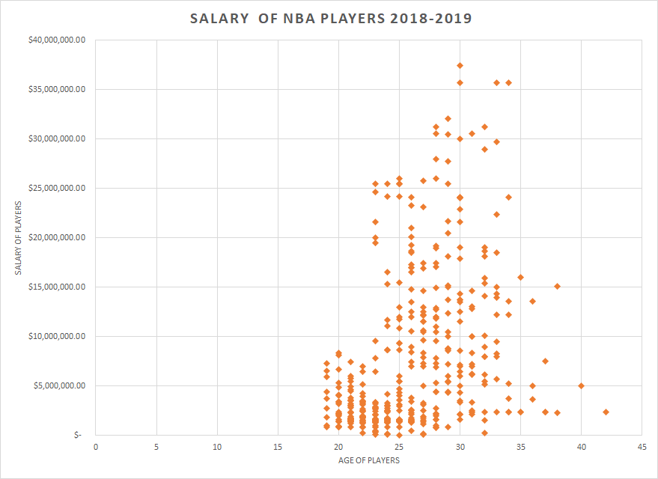
• Players that are 35 years and older have salaries lower than their younger teammates.
• The older the player is the lower their salary is.
• In 2018-2019, a 30-year-old basketball player had the highest salary.
• NBA players between the age of 25 and 34 earn the highest salaries

Slide 8
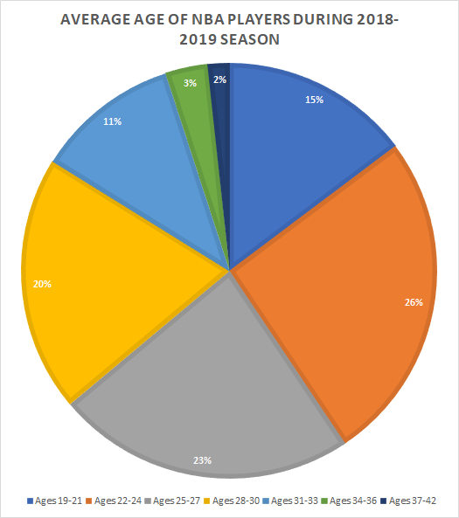
During the 2018-2019 season, 69% of NBA players are between the ages of 22 and 30 years old.
26% of all NBA players during 2018-2019 were between the ages of 22 and 24 years old.
Less than 2% of all NBA players during 2018-2019 were 37 and over.
3% of all NBA players during 2018-2019 were over the age of 34 and less than 37 years old.
During the NBA 2018-2019 season, the youngest basketball player was 19 years old while the oldest basketball player was 42 years old.

Slide 9
Methodologies
2 Data Sets
NBA Stats 2018-2019
NBA Rookies
Clusters
We ran for 2-8 clusters, and 2-10
Logit Regression
Ran logit of main players based on stats. Applied coefficients on first year player to see who was likely to get a PER of >20
Ran 3 scenarios for Logit Regression
Ran on shooting percentage only
Ran on all stats
Ran on all stats [assuming that all players played 32 minutes].

Slide 10
Clustering

Slide 11
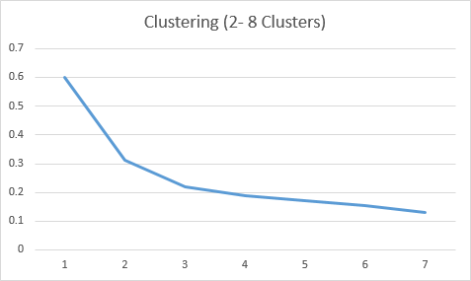
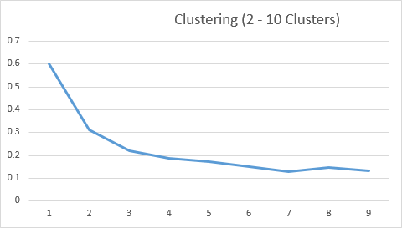


Clusters
Notes:
Clustering: we ran the first cluster on 8 – so a maximum of 8 clusters. This is the ratio we came up with for 8 clusters, and this is the ratio we came up with for 10 clusters
Based on the plots we concluded on 7 cluers.

Slide 12
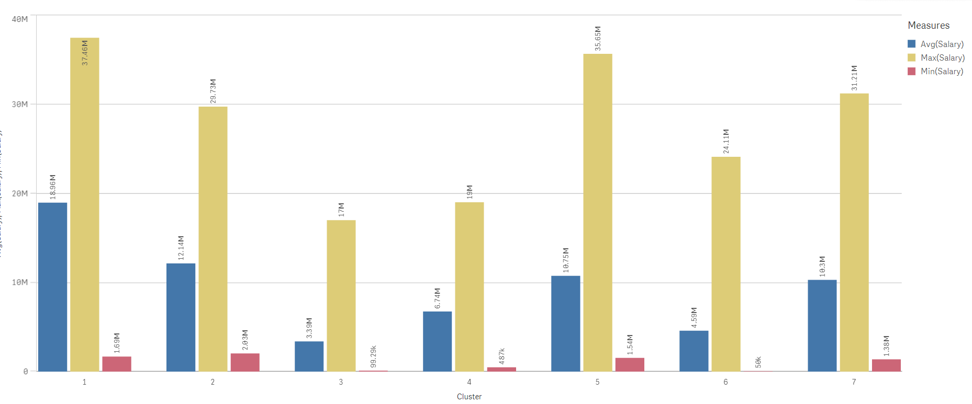
Salaries by Clusters
Notes:
Salary (Min/Max/Avg) & Age

Slide 13
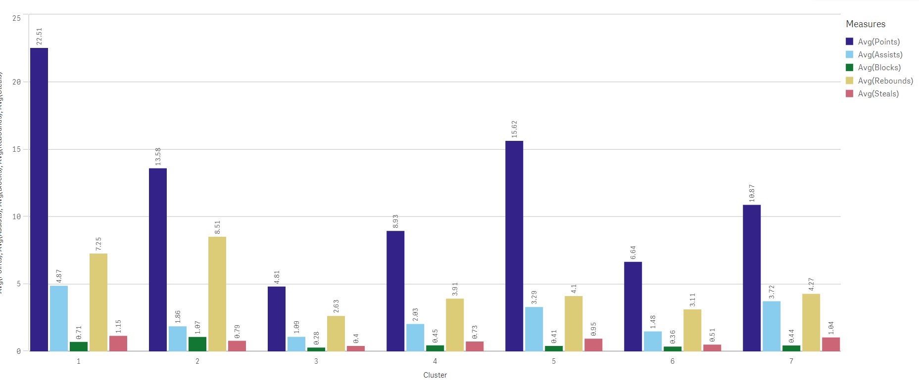
Cluster (Stats)
Notes:
Salary (Min/Max/Avg) & Age

Slide 14
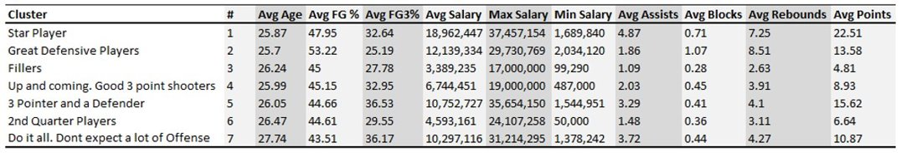
Cluster Findings

Slide 15
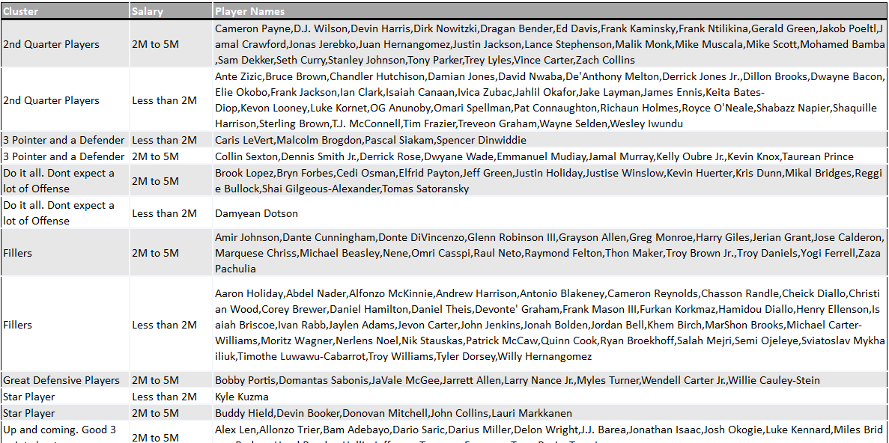

Slide 16
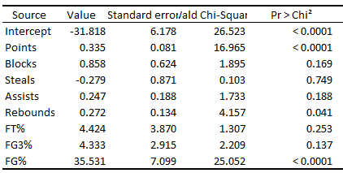
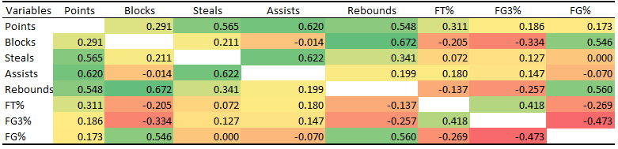
Logistic Regression on All Stats

Slide 17
Logistic Regression

Slide 18
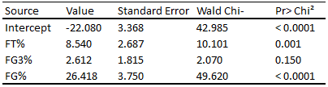
Logistic Regression (Only on shooting percentages)

Slide 19
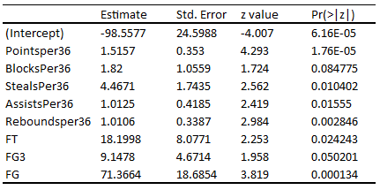
Logistic Regression
All Stats (Per 32 mins)

Slide 20
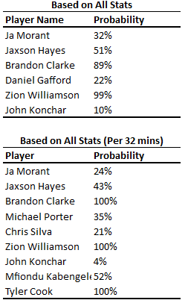
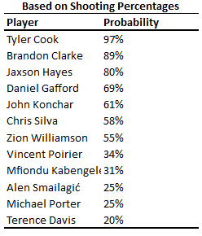
Logit Regression Results (Applied on 1st Year Players)

Slide 21
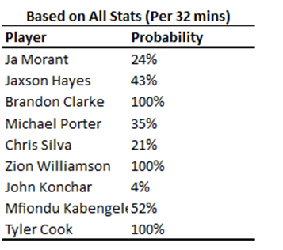
Conclusion
Logistics Regression
All Stats (Per 32)
Clusters

